Slide 1



Types of SSIS Automation
Notes:
If you have ever worked with SSIS packages you have at least thought about automation. And you might have done if by creating a database driven foreach tasks, highly parameterized packages or copying & pasting then modifying a package.

Slide 2
Benefits of Automated ETL Development
Efficiency
Automating the mass production of design patterns allows reliable solutions to drive operational processes.
Data Quality
Reliable ETL solutions lowers data quality risk.
Increased Productivity
An automated development solution generates opportunity for developers to work on additional projects and efforts.
Notes:
The idea of Automating SSIS package development is not new one and the benefits when realized are clear. It saves time and money.
Today, automation is so engrained in our development process that we often forget we are doing it, as a result the value is often overlooked.
Parameters and variables are used to achieve some level of automation in SSIS packages. Our CTS Standards encourage this by using variables and naming conventions and often our clients already have a design pattern in place for their ETL packages.

Slide 3
Copy and Paste Automation
One of our clients follows a standardized ETL convention, in addition they provided ample documentation on the queries to be used for the source and destination locations.
Our process for creating the ETL Packages was a follows:
1. Copy an existing ETL package
2. Modifying the Source
3. Modify the Destination
4. Modify the Names
5. Add Audit/Meta columns
6. Ensure Everything is Mapped Properly ←This was the majority of the work, the columns were not 1 to 1 and we were responsible for doing research
7. Test the Package
Notes:
When using a Standard Design as mentioned, Copy and Paste is often useful for reducing the amount of time it takes to create packages. While this practice is streamlined as much as possible, it time consuming and in my opinion, error prone due to repetitiveness. The only step that really requires human interaction is step 6. Using BIML, a novice developer following a tutorial could automate steps 1-5 within hours. Step 6 can be automated when column mappings are 1 to 1 or when you know the mappings in advance. In our situation this gives us much needed time for researching mapping issues and time to meet a demanding deadline.

Slide 4
What is Biml?
Biml is offered as a free Microsoft Visual Studio Add-In.
Biml can generate a variety of Microsoft SQL Server ETL objects:
SSIS Packages
SSAS Cubes
Tables
Notes:
BIML is a code generating utility capable of creating SSIS packages, SSAS cubes, and SQL Server tables.

Slide 5
What is Biml?
Biml is a dynamic code generating utility.
Biml: Business Intelligence Markup Language
Developed by Varigence.
Notes:
Before we begin, lets talk about BIML.
BIML is not open source. This is a product produced by Varigence.

Slide 6
What does Biml do?
Model SSIS Design Pattern in Biml
SSIS Package Template
Biml Code
Biml can Emulate SSIS Tasks and Transformations
Notes:
Create a template that hosts the design pattern
Model the package in Biml

Slide 7
What does Biml do?
SSIS Package: Table 1
Apply User Inputs
Code-Gen for Table 1
SSIS Package: Table 2
Execute Biml Script
Code-Gen for Table 2
SSIS Package: Table 3
Code-Gen for Table 3
Biml Code-Generates Packages Geared for Specific Table-Related Tasks
Notes:
Apply necessary input parameters into Biml; fro example, a table’s name.
Create the package(s) by executing Biml.

Slide 8
Benefit
Assume it takes 8 hours to develop Biml code that models a design pattern.
Working with the 20 minutes required to prep a template, Biml development time will break even when the 24th ETL solution is created.
For every hour of Biml development, the break even point is 3 ETL solutions.
Notes:
How does Biml pay for itself?

Slide 9
BIML == Creating a Template
Sharing is a Requirement
Reusability & BIML go hand in hand
Generalize & be Generic
Notes:
When you create a BIML script you are essentially creating a common template that can be called over and over again to create packages. Think of it as a function in code that returns a value. The value being returned in BIML script is a package.

Slide 10

Identifying BIML Candidates
Ask Questions -
What Changes?
What Stays the Same?
Is there a Pattern?
What databases are being used?
Notes:
Anytime you can copy & paste you could be using BIML

Slide 11
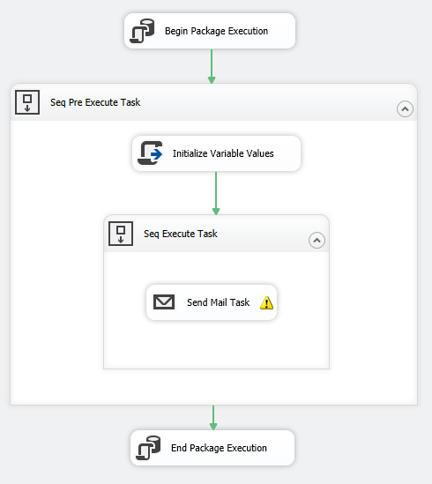
SSIS Package: 1
Design Pattern
Executes Non-ETL Related Tasks
Email
File Moves
TSQL Executions
Auditing: Consistent Documentation
One-To-One Relationship Between Package and Task

Slide 12
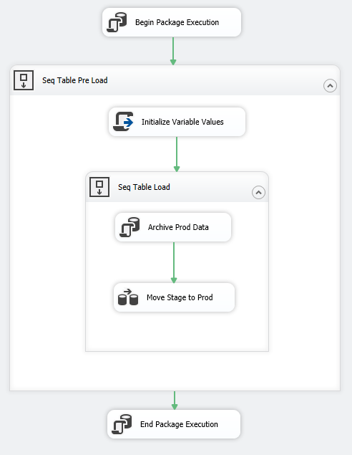
SSIS Package: 2
Design Pattern
Transports ‘Deleted’ Data to an Archive-Historical Table
Transports Staged Data to Production Table
Auditing: Consistent Documentation
One-To-One Relationship Between Package and Table
Impact on Key Business Elements

Slide 13
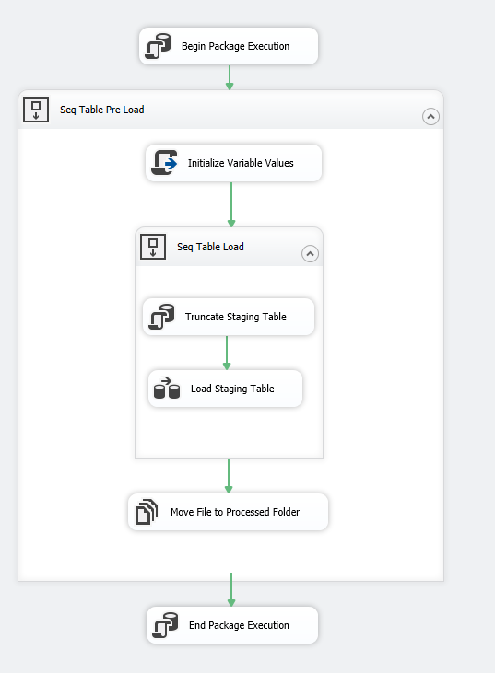
SSIS Package: 3
Design Pattern
Extracts Data from Feed
Transports Extracted Data into Staging Table
Moves a File to a ‘Processed’ Location
Auditing: Consistent Documentation
One-To-One Relationship Between Package and Feed
Data Source is Better Accounted For
One-To-One Relationship Between Package and Table
Impact on Key Business Elements

Slide 14
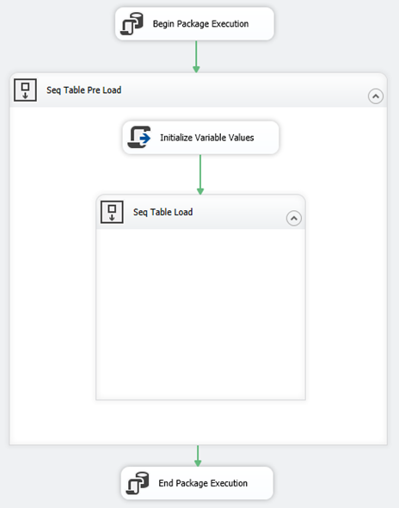
Is there a common pattern?
Notes:
At the bear minimum we can generate a template that implements the pattern above. What happens in the Sequential load can be automated as well.

Slide 15
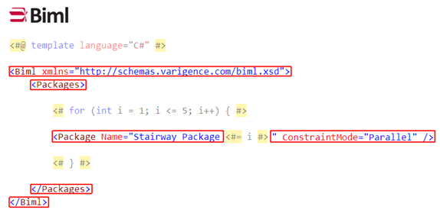
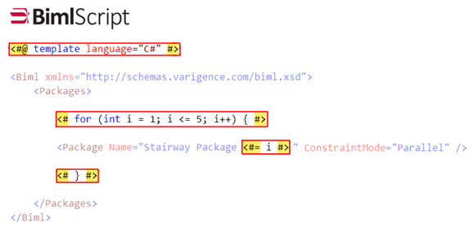
What does it look like?
Scripting Language
Similar to Razor or ASP.NET
Shares MVC Design Concept
Notes:
To get a better understanding of what BIML is, I will walk through a number of code examples.

Slide 16
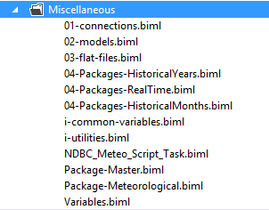
How is it Organized?
Tier Files
Include Files
CallBimlScripts()
C# Files
Notes:
BIML offers several different file types to use. I will walk through each type later in the presentation.

Slide 17
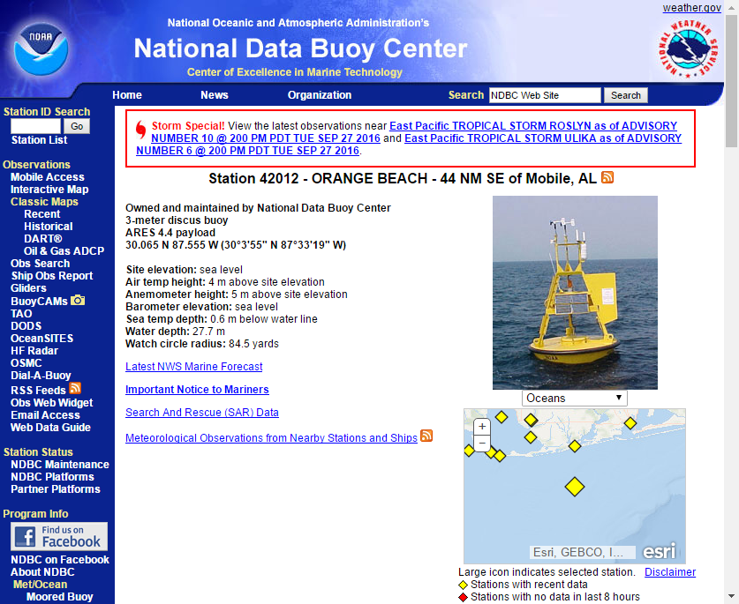
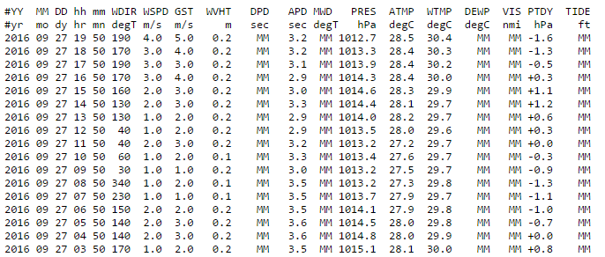
Biml Proof of Concept
Notes:
The Nation Data Buoy provides the public flat files for current and historical buoy data.

Slide 18
Data Available
RealTime – Reoccurring Job – 1 Package Processes 1 Buoy
This URL returns a Flat File for the Past 45 days
Monthly Historical – 1 Package Processes 1 Buoy’s Month
Year to Previous Month is Consolidated to ‘Monthly’ Flat Files
Each Month has its own URL
Yearly Historical – 1 Package Processes 1 Buoy’s Year
All Previous Years are consolidated to ‘Yearly’ Flat Files
Available Yearly files are dependent on the Buoy some have more than others
Each Year has its own URL
Notes:
Historical data is a one time load, after those packages are executed they can be deleted.

Slide 19
What Changes?
The HTTP Connection String
Source SQL Query for Cache
Number of Packages Generated
Year & Monthly have their own Master Package

Slide 20
Why use Multiple Packages for this?
Visibility
Its easy to look at the master package and tell if something failed.
No package is dependent on another if one fails it keeps going.
Portability
Biml Exposure – The original packages had an example of pretty much everything I needed to learn and it’s a real world example.
Notes:
In preparation for my SSIS project at work, I created the original SSIS package for importing the buoy data into my home Postgres SQL Server. The original package uses a foreach loop to grab the data for multiple buoys using the realtime URL only. This package could not be used for historical data. In order to accommodate the historical data loads I would have had to heavily parameterize the realtime package or create new ones. With Biml I have realtime and historical all in one shot.

Slide 21



Why Buoy Data?
Notes:
Imagine your at the beach and it’s the perfect day. The rip current is not bad, the surf is perfect, not too rough closer to the shore but big enough for the surfers in the distance.
Or how about kayaking and the water is perfectly still, there are dauphins swimming all around and the sky is beautiful.
For a long time I thought it was just magic like Santa Cause. However after extensive research I realized that it has a lot to do with the swell height and wind direction. Which is publically available through the NBDC.

Slide 22
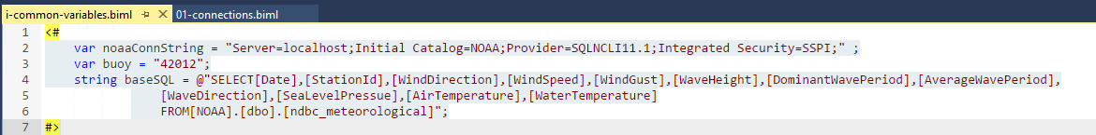
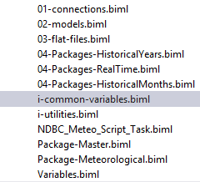
C# Files - Don’t Repeat Yourself
C# Variables are encouraged
Notes:
If it can be reused it should be in a variable

Slide 23
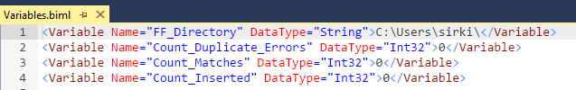
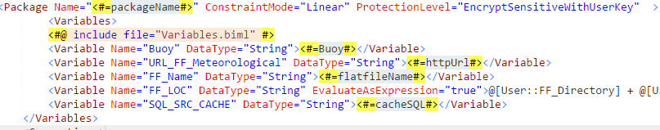
Include Files
Notes:
Include files are common files that do not change. These values are static and are shared but not changed across packages.

Slide 24
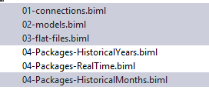
Tiers –Organize BIML Files
Notes:
Tiers can be thought of like partial views in MVC. In our case we have 3 different package templates that can be generated.

Slide 25
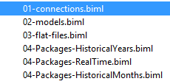
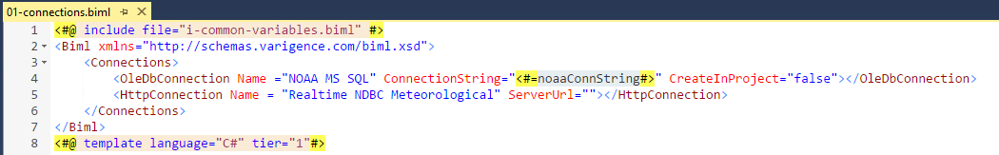
Connection Manager Tier
Notes:
This is where you define your connections. As you can see we are using the ConnectionString C# variable that is defined in our common file. Notice only the HTTP Connection and SQL Instances are defined here. The cache and flat files are defined in the flat file tier which we will get into later.

Slide 26
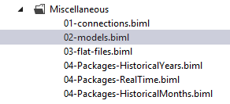
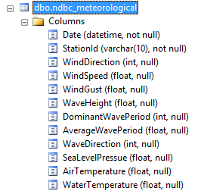
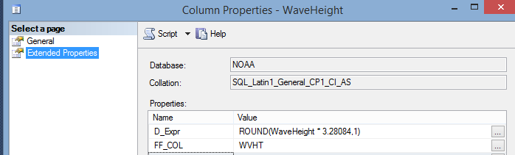
Models
Same as Database First Models in MVC
A Table Schema is Represented as a C# Object
Implements Data Annotation Properties
Notes:
One of the coolest features of the Biml C# framework is its ability to create Models from a database schema. This allows you to grab what you need once and use it later on and you end up using the table schema a lot.

Slide 27
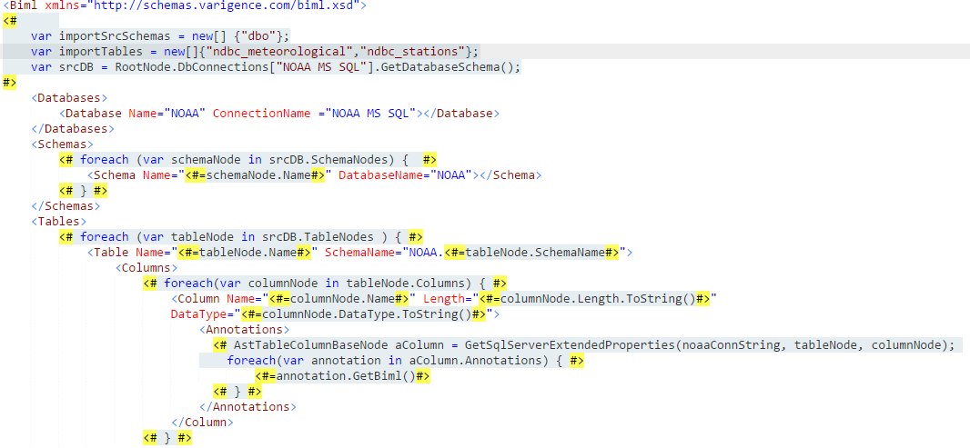
Models continued
Notes:
While I do not intend to walk through this code. I do want to point out that this is all done dynamically. In this situation it creates a table Model for each table in the our database.

Slide 28
National Data Buoy Center

Slide 29
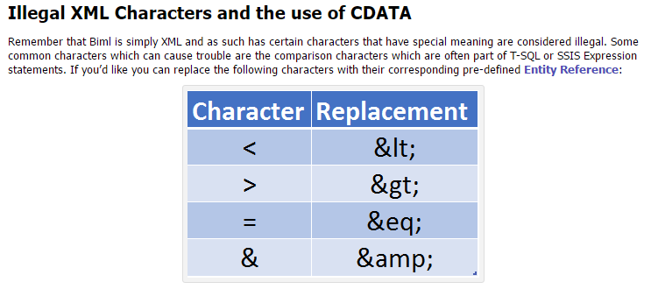
Pitfalls
Notes:
While this is an XML pitfall, escaping characters in XML is not the cleanest of ways do to things. Im my case I had a url that was littered with things that needed to be escaped and it was a C# variable. After trial and error I ended up wrapping it with CDATA

Slide 30
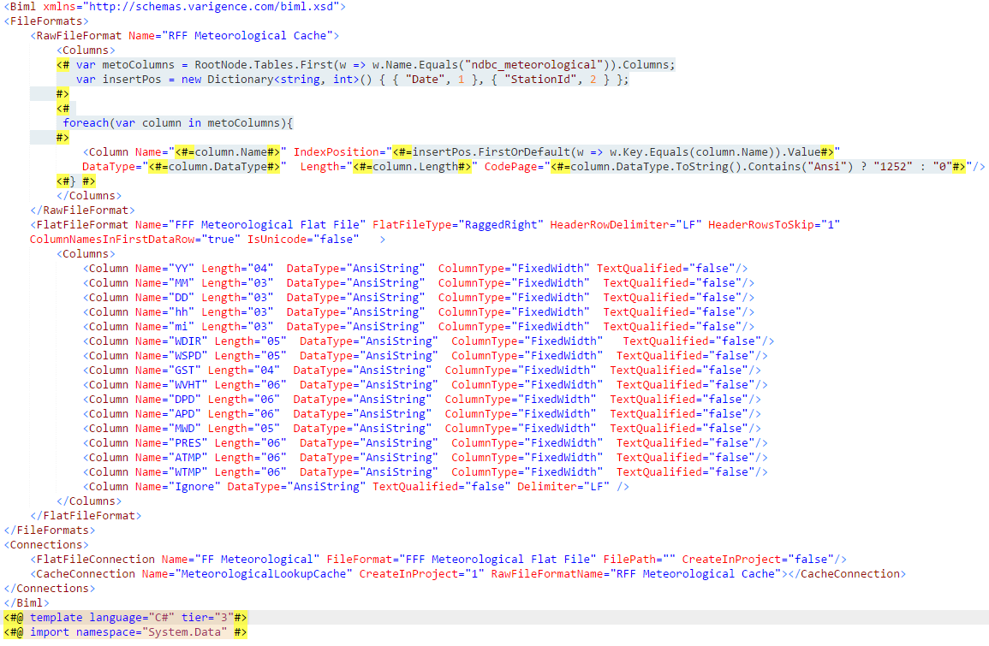
Pitfalls: Flat Files & SQL Cache ☹
Notes:
Working with Flat Files and SQL Cache in Visual studio is seamless, in BIML there is a learning curve. Using a SQL Cache requires you to define a flat file format for it. While the end result code is not complex, it takes a little be of trial and error to get it just right.

